Slide 1
Methodology in AI
222070 仇隽 in G1
4.13

Slide 2
Methodology in AI
FIVE PAPERs：
Algorithm:
Online normalizer calculation for softmax, (Milakov & Gimelshein, 2018)
FlashAttention: Fast and Memory-Efficient Exact Attention with IO-Awareness, (Dao et al., 2022)
Model:
Attention Is All You Need, (Vaswani et al., 2017)
LLaMA: Open and Efficient Foundation Language Models, (Touvron et al., n.d.)
Survey:
The Deep Learning Compiler: A Comprehensive Survey, (Li et al., 2021)

Slide 3
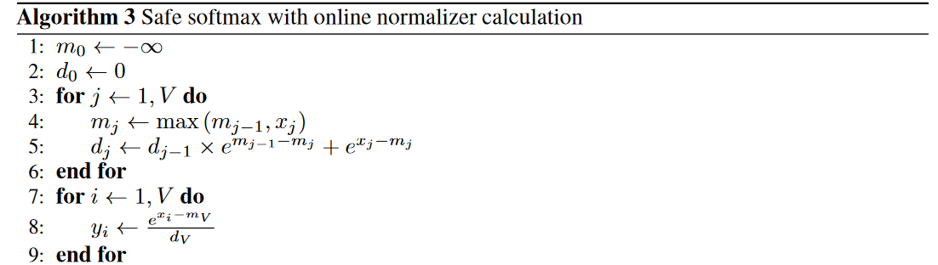
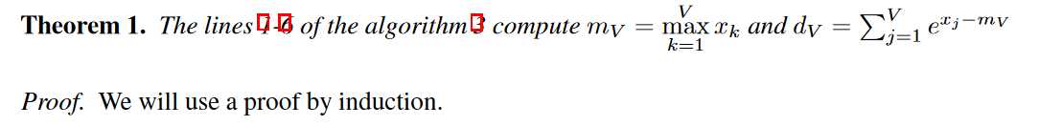
Algorithm
In Online normalizer calculation for softmax
Recent work / Old algorithm
Our new algorithm implementation & Contrast
Algorithm feasibility proof

Slide 4
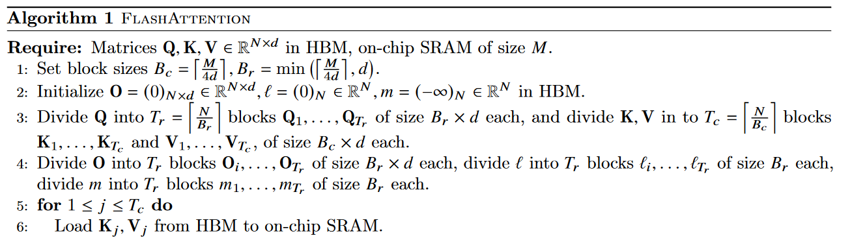
Algorithm
In FlashAttention: Fast and Memory-Efficient Exact Attention with IO-Awareness
Recent work / Old algorithm
Our new algorithm implementation & Contrast
Where these ideas come from & How we use these algorithms

Slide 5
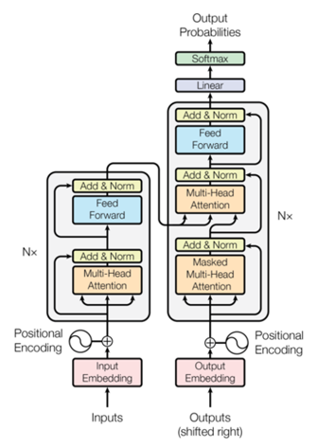
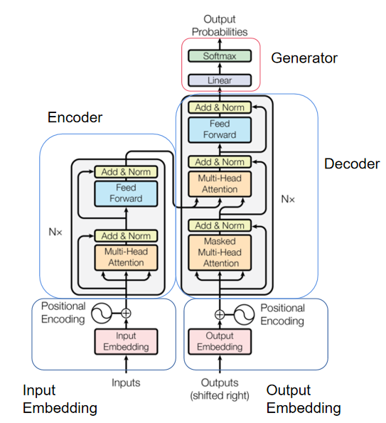
Model
In Attention Is All You Need
Model Overview
Component Implementation

Slide 6
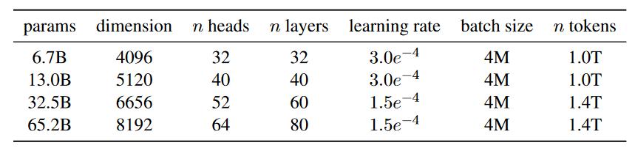
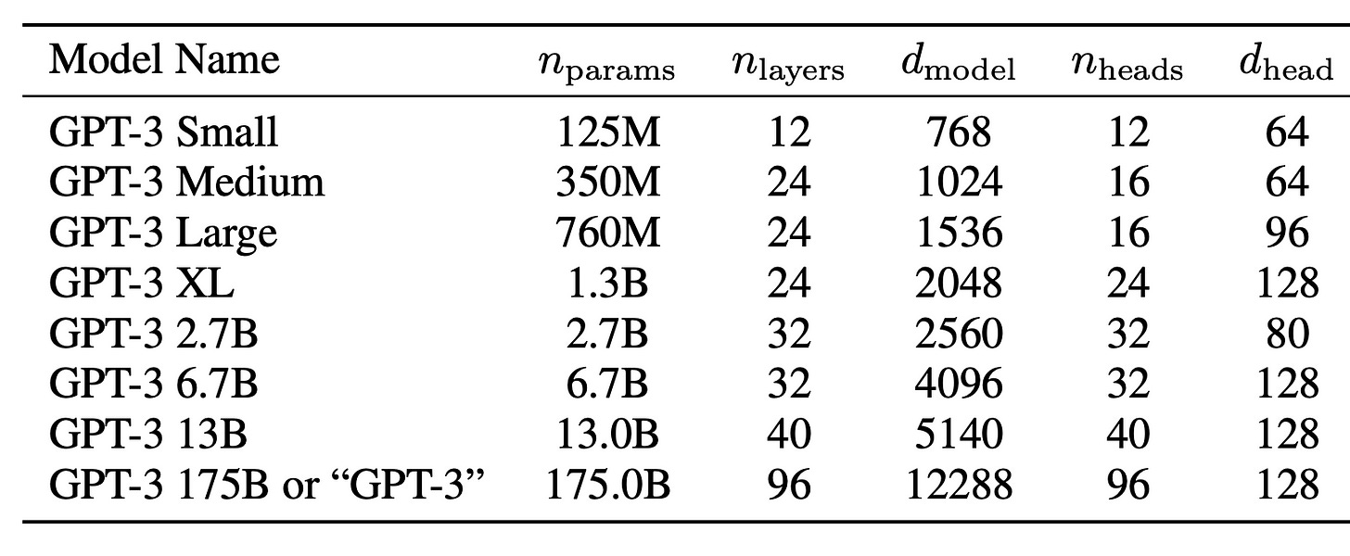
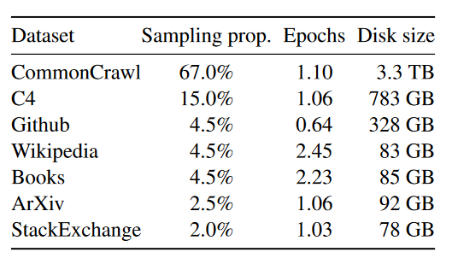
Model
In LLaMA: Open and Efficient Foundation Language Models
The basic model
Modification & Novel Implementation
Model Size:
Architecture: traditional transformer arch
Pre-normalization [GPT3]
SwiGLU activation function [PaLM]
Rotary Embeddings [GPTNeo]
Pre-training Data:
Other efficient implementation:
Multi-head attention operator [FlashAttention]
Reduce the amount of activations
Use all_reduce operations

Slide 7
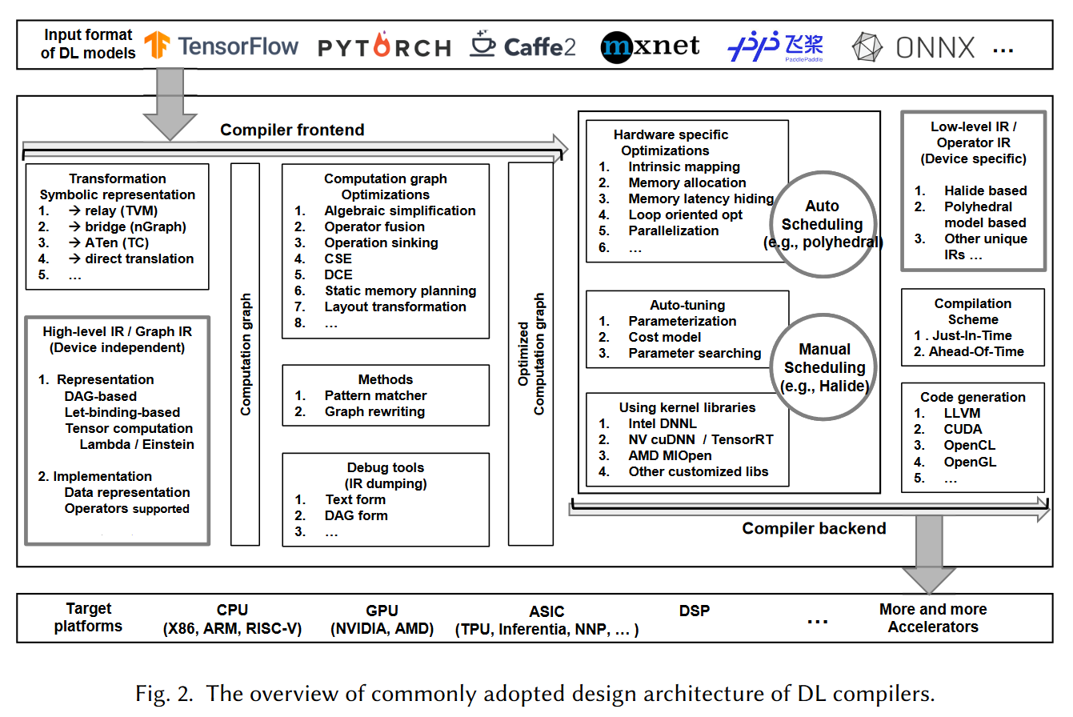
Survey
In The Deep Learning Compiler: A Comprehensive Survey
What is DL Compiler？
What is in the DL Compiler？

Slide 8
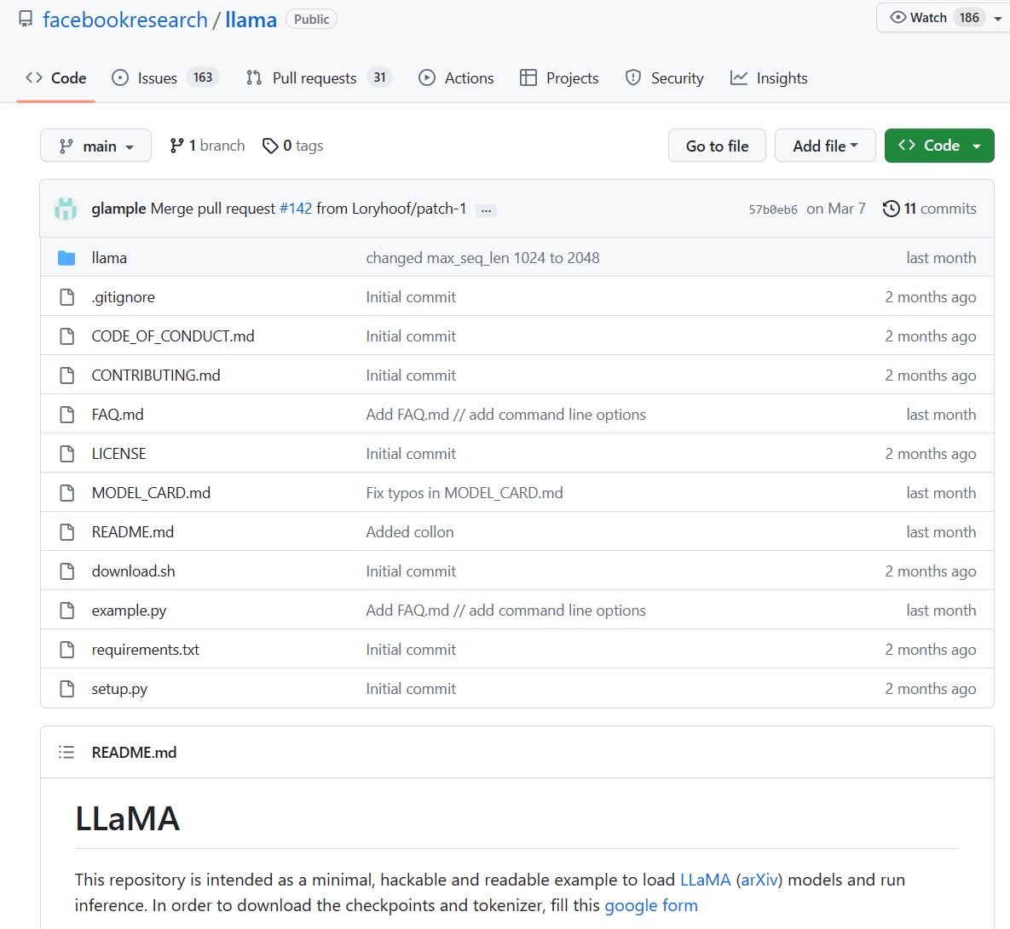
Repository
code & result
https://github.com/facebookresearch/llama

Slide 9
Thank you

